Slide 1
The Adapter Pattern
Dr. Clarence LAU

Slide 2
Intent
Convert the interface of a class into another interface clients expect.
Adapter lets classes work together that couldn't otherwise because of incompatible interfaces.
Also Known As Wrapper

Slide 3

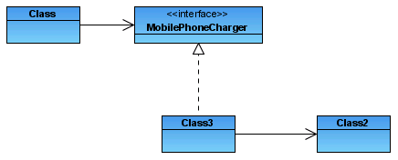
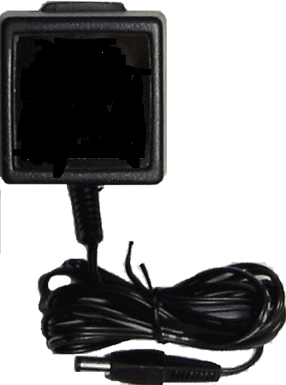

Real Life Example
Target (9 V, 500 mA)
Client
Adapter
Adaptee (220 Volts)

Slide 4
Motivation
Sometimes a toolkit or class library can not be used because its interface is incompatible with the interface required by an application
We can not change the library interface, since we may not have its source code
Even if we did have the source code, we probably should not change the library for each domain-specific application

Slide 5
Roles
Client uses Target interface/class in its codes.
Target defines the interface/class which Client uses.
Adaptee is the actually class which provides the required function to Client, and its interface is not compatible to Target.
Adapter converts the Adaptee’s interface to the Target’s interface so that Client can use Adaptee’s method(s).

Slide 6
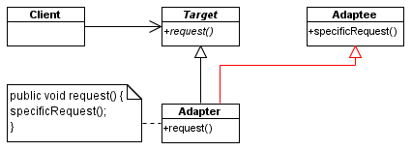
Class Adapter
The Class Adapter pattern - This type of adapter uses multiple inheritance to achieve its goal. The adapter is created inheriting interfaces from both the interface that is expected and the interface that is pre-existing. Note that when the adapter must adapt multiple adaptees, the Class Adapter pattern cannot be used in languages such as Java that do not support multiple inheritance.
Class Adapter

Slide 7
Class Adapter
Class adapters use multiple inheritance to achieve their goals.
The class adapter inherits the interface of the client's target. However, it also inherits the interface of the adaptee as well.
Since Java does not support true multiple inheritance, this means that one of the interfaces must be inherited from a Java Interface type.
Note that either or both of the target or adaptee interfaces could be an Java Interfaces.
The request to the target is simply rerouted to the specific request that was inherited fro the adaptee interface.

Slide 8
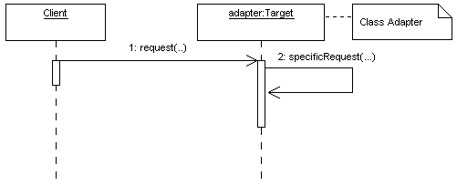
Class Adapter

Slide 9
Class Adapter
interface Target {
abstract public void request();
}
class Client {
Target target;
public Client(Target adapter) {target = adapter;}
public someMethod() {
target.request();
}
}
class Adapter extends Adaptee implements Target {
public void request() {
specificRequest();
}
}
Class Adapter inherits Adaptee’s method
Method from Adaptee

Slide 10
Class Adapter
class Main {
public static void main(String[] args) {
Target adapter = new Adapter();
Client client = new Client(adapter);
client.someMethod();
}
}

Slide 11
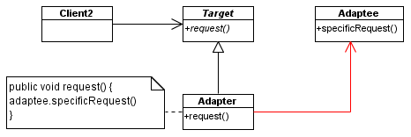
Object Adapter
An object adapter relies on object composition:

Slide 12
Object Adapter
Object adapters use a compositional technique to adapt one interface to another.
The adapter inherits the target interface that the client expects to see, while it holds an instance the adaptee.
When the client calls the request() method on its target object (the adapter), the request is translated into the corresponding specific request on the adaptee.

Slide 13
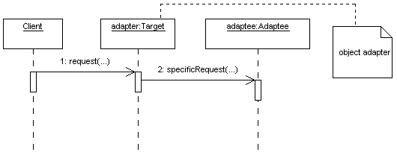
Structure (Object Adapter)

Slide 14
Object Adapter
class Adapter implements Target {
Adaptee adaptee;
public Adapter(Adaptee adaptee) {
this.adaptee = adaptee;
}
public void request() {
adaptee.specificRequest();
}
}
class Main {
public static void main(String[] args) {
Target adapter = new Adapter(new Adaptee());
Client client = new Client(adapter);
client.someMethod();
}
}
Object Adapter does not inherit Adaptee’s method. Instead, it uses an Adaptee’s object.

Slide 15
Comparison of Class and Object Adapters
Inheritance
Association
Class Adapter
Object Adapter

Slide 16
Comparison of Class and Object Adapters
Class Adapter
Calls inherited method of superclass Adapter
Object Adapter
Calls method of Adaptee object

Slide 17
Comparison of Class and Object Adapters
class Adapter implements Target {
Adaptee adaptee;
public Adapter(Adaptee adaptee) {
this.adaptee = adaptee;
}
public void request() {
adaptee.specificRequest();
}
}
class Adapter extends Adaptee implements Target {
public void request() {
specificRequest();
}
}
Class Adapter
Object Adapter

Slide 18
Comparison of Class and Object Adapters
class Main {
public static void main(String[] args) {
Target adapter = new Adapter();
Client client = new Client(adapter);
client.someMethod();
}
}
class Main {
public static void main(String[] args) {
Target adapter = new Adapter(new Adaptee());
Client client = new Client(adapter);
client.someMethod();
}
}
Class Adapter
Object Adapter

Slide 19

Example 1
If a client only understands the SquarePeg interface for inserting pegs using the insert() method, how can it uses round pegs?
A peg adapter!

Slide 20
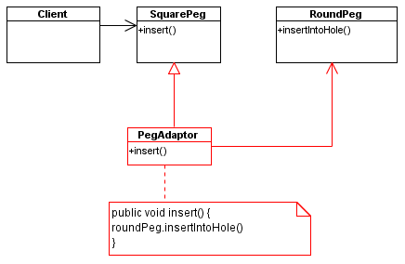
Example 1

Slide 21
Example 1
/**
* The SquarePeg class.
* This is the Target class.
*/
public class SquarePeg {
  public void insert(String str) {
    System.out.println("SquarePeg insert(): " + str);
  }
}

Slide 22
Example 1
/**
* The RoundPeg class.
* This is the Adaptee class.
*/
public class RoundPeg {
  public void insertIntoHole(String msg) {
    System.out.println("RoundPeg insertIntoHole(): " + msg);
  }
}

Slide 23
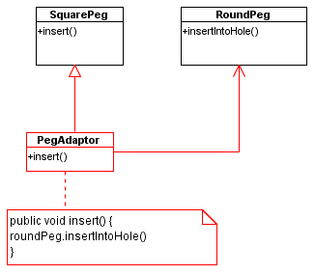
Example 1
/**
* The PegAdapter class.
* This is the Adapter class.
* It adapts a RoundPeg to a SquarePeg.
* Its interface is that of a SquarePeg.
*/
public class PegAdapter extends SquarePeg {
  private RoundPeg roundPeg;
  public PegAdapter(RoundPeg peg) {
    this.roundPeg = peg;
  }
  public void insert(String str) {
    roundPeg.insertIntoHole(str);
  }
}

Slide 24
Example 1
// Test program for Pegs.
public class TestPegs {
  public static void main(String args[]) {
    // Create some pegs.
    RoundPeg roundPeg = new RoundPeg();
    SquarePeg squarePeg = new SquarePeg();
    // Do an insert using the square peg.
    squarePeg.insert("Inserting square peg...");
    // Create a PegAdapter
    SquarePeg adapter = new PegAdapter(roundPeg);
    adapter.insert("Inserting round peg...");
  }
}

Slide 25
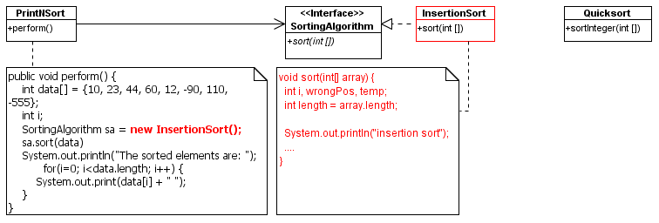
PrintNSort
Quick sort class binary file is available without source code!
Want to use the sortInteger method of QuickSort in PrintNSort but the interface is not compatible! Quicksort class cannot be modified because of no source code available!

Slide 26
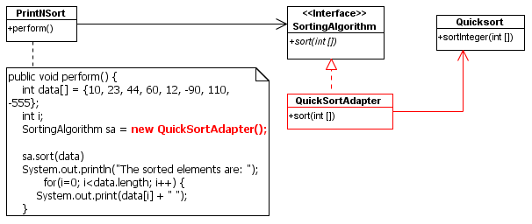
PrintNSort

Slide 27
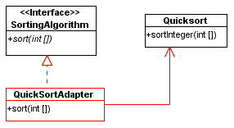
PrintNSort
public class QuickSortAdapter implements SortingAlgorithm {
Quicksort qs;
public QuickSortAdapter() {
qs = new Quicksort();
}
public void sort(int[] array) {
System.out.println("QuickSortAdapter: sort()");
qs.sortInteger(array);
}
}

Slide 28
Java Swing
The Java Swing GUI components are designed to provide a generic platform for GUI programming.
The Control class of an application is designed to support multiple GUI platforms.

Slide 29
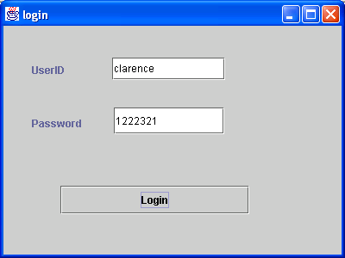
Java Swing

Slide 30
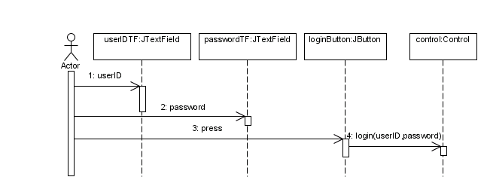
Java Swing
The login button needs to call the control object but the interface is incompatible! The login button cannot directly call the login method of the Control class!

Slide 31
Java Swing
JButton expects an ActionListener interface and calls the actionPerformed method.
Control class provides the login method.
The interface is incompatible!
Use adapter!

Slide 32
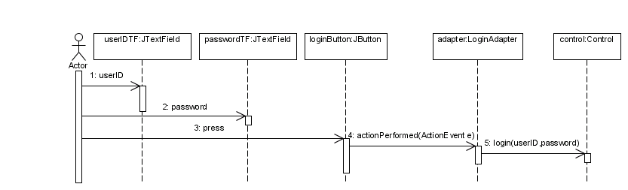
Java Swing
The LoginAdapter is needed to bridge the difference in interface used by JButton and the interface provided by the Control class.

Slide 33
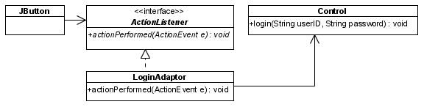
Java Swing
public void actionPerformed(ActionEvent e) {
control.login(userIDTF.getText(), passwordTF.getText());
}

Slide 34
Java Swing
import java.awt.event.*;
import javax.swing.*;
public class LoginAdapter implements ActionListener {
Control control;
JTextField userIDTF;
JTextField passwordTF;
public LoginAdapter(JTextField userIDTF, JTextField passwordTF, Control control) {
this.control = control;
this.userIDTF = userIDTF;
this.passwordTF = passwordTF; }
public void actionPerformed(ActionEvent e) {
control.login(userIDTF.getText(), passwordTF.getText());
}
}

